Slide 1

MongoDB for Developers
Module 01 - Introduction

Slide 2
No SQL Datastores
Store and manage data in ways that allow for high operational speed and great flexibility
Common No SQL models:
Document databases
Key-value stores
Wide column stores
Graph databases
Notes:
Document – stored as free-form JSON or “documents” e.g: MongoDB, CouchDB
Key value – distributed dictionary (or Hash table), accessed by the key. e.g: Redis, Riak
Wide column – stored in columns instead of rows(as in RDBMS) e.g: Hbase, Cassandra
Graph – represented as graph of entities and their relationships, each node contains a free-form of data e.g: Neo4j

Slide 3
NoSQL vs RDBMS
Not required to define schema first, which makes it much easier to update as your data and requirements change
Designed to handle unstructured data like text, video social media posts etc.
NoSQL scale horizontally which considered more chipper than scaling vertically
No need to develop a detailed database model, which saves a lot of development time
Notes:
Scaling Types:
Horizontally – adding more cheap commodity servers
Vertically – increasing the current server hardware power ,or need to buy expensive and bigger server
Detailed database model – like the entity-relationship model which defines the entities and their relations in a RDBMS

Slide 4
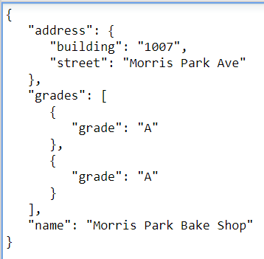
Introduction to MongoDB
Open-source, No SQL, document DB that provides high availability, high performance and horizontal scalability
Written in C++
Ranked as the most popular document
database(DB-Engine)
Notes:
High availability - characteristic of a system, which aims to ensure an agreed level of operational performance, usually uptime, for a higher than normal period
High performance – ensures read/write faster than usual DB systems
Horizontal scalability - provides it by using shards to distribute the data across the cluster
The Community edition has no limitations in the aspects of memory or storage size
Some of the common Enterprise edition features:
Kerberos and LDAP security solutions
Backup and Monitoring solution
Support and training contract

Slide 5
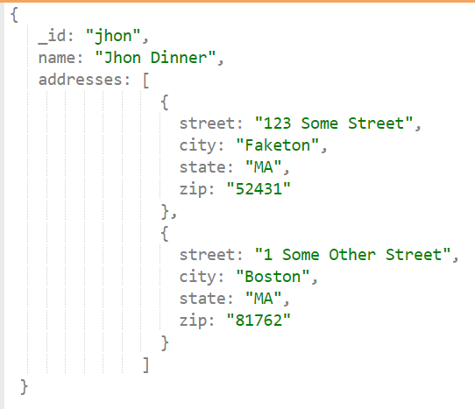
Introduction to MongoDB – Key Features
High performance
Embedded data models reduces I/O operations
Indexes for faster queries
Advanced query language features
Aggregations
Text searches and Geospatial
High availability
Automatic failover
Data redundancy
embedded
embedded
Notes:
Embedded docs – object or docs within another docs. It reduces I/O because otherwise you need to separate the doc to another collection(addresses), and when you want to search, or write you need to do two requests to Mongo instead of one

Slide 6
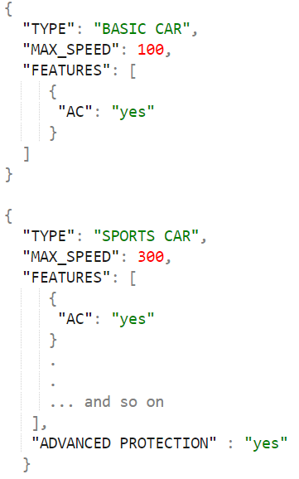
Introduction to MongoDB - Document
Each record stored as a BSON document,
a Binary JSON
Some advantages:
Correspond to native data types in many
Programming languages(especially JavaScript)
Reduce the need of expensive joins
Schema less supports polymorphic types
Notes:
JSON - data structure composed of field and value pairs, key is string, and value can be anything(String, number, Array, document, Array of documents etc.)
BSON - extension of JSON including support of data types
Expensive joins – because the data is denormalized, there is no separate relations, we basically don’t need joins
Polymorphic type – has properties that can also be applied to values of some other type, or types (example in the picture above)

Slide 7
Introduction to MongoDB – Terminology
SQL terms vs MongoDB:
Relational DB | MongoDB
Database | Database
Table | Collection
Row | JSON documents
Column | Field
Index | Index
Table joins | $lookup, embedded documents
Primary key | The primary key automatically set to the _id filed
Notes:
$lookup – aggregation operator that performs left outer join to an unsharded collection in the same database
embedded documents – at least one document that resides inside another document

Slide 8
Use Cases
Basically mongo is a general purpose DB for variety of use cases
It can be used instead of RDBMS for better application performance, scale and developers productivity
Baidu first migrating their user address book service from MySQL to MongoDB because they had performance and scalability limits
Now they use a giant MongoDB cluster(650 nodes), storing over 1PB of data, for over 100 different products
Notes:
Baidu – one of the largest internet companies in the world(more common in China)

Slide 9
Use Cases
Customer Usage Analytics:
Store and analyze button clicks, user goals, which pages/modules aren't in use
For example: Apteligent use MongoDB to analyze mobile apps with more than 4 billion requests per day
Real Time Analytics:
Apps that required sub-second latency, and extreme rarely downtime
For example: analyze tweets, social posts, financial reports and more to inform trading algorithms in real time
Notes:
Apteligent – analyze app crashes, performance over versions, users flows, users actions and more insights for mobile apps. Used by eBay, Netflix, Snapchat etc.

Slide 10
MongoDB Server Installation on Windows
Download the .msi file and install it:
https://bit.ly/2t589Yx
Create those directories in:
C:\Program Files\MongoDB\Server\3.6\data\db
Execute in cmd(as administrator):
C:\Program Files\MongoDB\Server\3.6\bin\mongod.exe --dbpath
C:\Program Files\MongoDB\Server\3.6\data\db
Notes:
There is a lot of configurations, you can see them by execute mongod.exe ---help
You can choose other data directory, pay attention to change the -–dbpath as well

Slide 11
MongoDB Client Tools
Compass is the most common UI tool to interact with mongo
For quick operations, you can use the shell (JavaScript interpreter)
For development purposes, we use the varied Drivers: C++, C#, Node.js, Java, Python etc.
Notes:
Compass available as commercial or community product. The community edition enables you to:
View, add, and delete databases and collections
Full CRUD functionality over the documents
Run queries, and view the documents
Optimize queries with visual explain plans
View stats, create, and delete indexes
After you’ve installed MongoDB, you can start the shell from the <INSTALLED_PATH>\bin\mongo.exe
The full list of drivers: https://docs.mongodb.com/ecosystem/drivers/

Slide 12
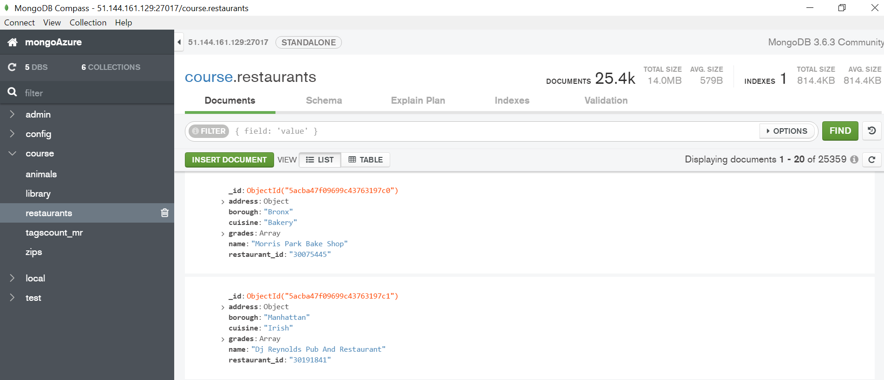
Compass

